Slide 1
Searching and Sorting Algorithms
Unit 2
CPRG304 – Object-Oriented Programming III

Slide 2
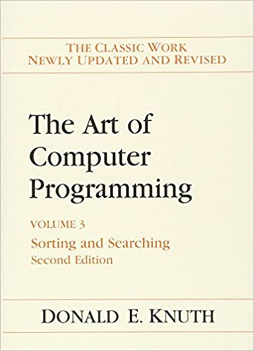
Searching and Sorting
Donald Knuth:
  “Indeed, I believe that virtually every important aspect of programming arises somewhere in the context of sorting or searching!”
It’s what all our software must do!
  We interact with data to locate a specific item = searching
  To find something easier, we have to order it in a specific way = sorting
How our data is stored affects how we can search and sort!
Notes:
Using different data structures will dictate how our code can traverse and access every item! Thus “Data structures and algorithms”!!!

Slide 3
Arrays
A sequence of indexed elements:
The size of the array is fixed when the array is constructed
  Static-sized, cannot be changed
Each array element has a fixed and unique index
  The index range from a lower bound to an upper bound
Any array element can be accessed in O(1) time
  Inspected or updated
low
low+1
low+2
high-2
high-1
high
array indexes
a
array elements
Notes:
A vector (or mutable Python arrays) is just an illusion – an array that is re-created to be bigger when you reach the max size!

Slide 4
Java Arrays
A Java array consist of elements are either values of a primitive type or objects of a class
  A Java array of length n has indexes of lower bound 0 and upper bound n–1
A Java array is itself an object, allocated dynamically by new T[n]
class tag
length
0
1
n–2
n–1
a
T[]
n
array elements
Notes:
Array identifier = a, stored in array of memory (stack). T = type of data → T[ ] = array of data type T.

Slide 5
Java Primitive Array
Example: int[] primes = {2, 3, 5, 7, 11};
Arrays are an object in Java
  Created during run-time (dynamically allocated)
  Resides in dynamic memory (the Java heap)
    The area of memory used to store objects instantiated by the JVM (run-time)
class tag
length
0
1
2
3
4
primes
int[]
5
2
3
5
7
11
Notes:
The heap has a default size which varies with the version of the JVM, this value can be modified through a setting.

Slide 6
Java Object Array
Example: Date[] holidays = new Date[3];
holidays[0] = new Date(2024, 10, 11);
holidays[1] = new Date(2024, 11, 11);
holidays[2] = new Date(2024, 12, 25);
class tag
length
0
1
2
holidays
Date[]
3
class tag
y
m
d
Date
2024
12
25
class tag
y
m
d
Date
2024
11
11
class tag
y
m
d
Date
2024
10
11

Slide 7
Subarrays
A sequence of consecutive elements that forms a part of a larger array
Notation: let a[l..r] be the subarray consisting of elements a[l], …, a[r]
  Subarray notation is used here, but is not supported by Java
  Length of subarray a[l..r] is r – l + 1
0
1
2
3
4
5
6
7
8
9
a
subarray a[1..3]
subarray a[6..9]
Notes:
Another popular notation uses a colon – a [l : r].

Slide 8
Sorted Arrays
A (sub)array is sorted if its elements are in ascending order
  i.e., each element is less than or equal to the element on its right
The meaning of the comparison “x is less than y” must be defined for each data type
  Meaning of less for numbers:
    x is numerically less than y, i.e., x < y
  Conventional meaning of less for Strings:
    x precedes y lexicographically (dictionary order) E.g.: “bat” is less than “bath”, which is less than “bay”
  Conventional meaning of less for Date:
    Today precedes tomorrow (“earlier”)
Notes:
Sorting by default, implies it is in ascending order… but we could also explicitly state that a collection of data is sorted in descending order – where every element is greater than or equal to the element on its right.
Note: this comparison is the core of sorting data! We must have a way to compare 2 elements and determine which is “less”. Primitive types in Java uses the comparison operators, but what about all other data types?

Slide 9
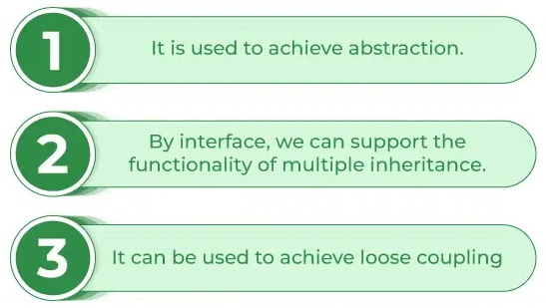
Java Interfaces
Defines an abstract type to specify the behavior of a class!
  Can have static constants
  Can only have abstract methods (no implementation)
Notes:
Img src = “https://www.geeksforgeeks.org/interfaces-in-java/”
Review: https://www.w3schools.com/cs/cs_interface.php
Check out the “abstractVSinterface.pdf” on D2L under Contents -> Student Resources

Slide 10
Comparable vs Comparator
Java provides 2 interfaces for comparisons:
public interface Comparable<T>
  For objects that have a natural order
public interface Comparator<T>
  For objects that:
    Can have multiple comparison attributes
    You have no control over
    Needs to implement the Strategy design pattern
Notes:
https://www.geeksforgeeks.org/comparable-vs-comparator-in-java/
Read more about the strategy pattern if you’re interested - https://en.wikipedia.org/wiki/Strategy_pattern
Interfaces in Java does NOT start with the letter ‘I’!

Slide 11
The Comparable Interface
If a class implements Comparable, it must implement compareTo() in accordance with its “contract”
/** @return a negative integer if this object is less than that,
* or zero if this object is equal to that,
* or a positive integer if this object is greater than that. */
public int compareTo(T that);
The compareTo method captures the notion of less or greater than for objects
Notes:
Throws:
NullPointerException - if the specified object is null
ClassCastException - if the specified object's type prevents it from being compared to this object

Slide 12
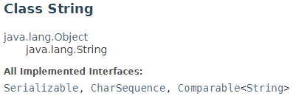
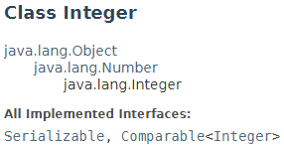
Brief Introduction to Generics
The <T> is like a placeholder
  Allows it to be replaced by an actual type later!
  Done by the class implementing the interface
Why not use Object?
  Everything is a Object!
    We can’t compare “cat” with 42
    Java can’t enforce types
Notes:
Java is a strongly-typed language, this means that the JVM will always try to enforce data types for us and will not allow us to mix data types!

Slide 13
The Comparator Interface
An external class (or multiple classes) that implements Comparator can be used
The compare() method implements the comparison of objects to impose an order
/** @return a negative integer if the first object is less than
* the second object,
* or zero if the first object is equal to the second object,
* or a positive integer if the first object is greater than the
* second object */
public int compare(T o1, T o2);
Notes:
Check out the Student classes in comparableVsComparator package!

Slide 14
Manipulating Arrays
How do you find an element in an array of n elements?
  Via index: direct access – O(1)
  Via a value of the element: sequential – O(n)
Add an element?
  Must shift every element to the right to make room
    O(n)
Remove an element?
  Must shift every element to the left to fill the gap
    O(n)
0
1
2
3
4
5
6
7
8
9
a

Slide 15
Array Insertions
Given a (sub)array a[left..right], insert a value val at a[ins]
  If necessary, shift values right to make room for it
Array insertion algorithm to insert val at index ins in a[left..right], where left ≤ ins ≤ right):
    Copy a[ins..right] into a[ins+1…right+1]
    Copy val into a[ins]
    Terminate
Notes:
If you’re searching for the element first – that’s another O(n) you’re doing first!

Slide 16
Array Deletions
Given a (sub)array a[left..right], delete the value at a[del]
  If necessary, shift values left to fill the gap
Array deletion algorithm to delete the value at index del in a[left..right], where left ≤ del ≤ right):
    Copy a[del+1..right] into a[del…right-1]
    Make a[right] unoccupied
    Terminate
Notes:
If you’re searching for the element first – that’s another O(n) you’re doing first!

Slide 17
Another Way to Search an Array
What we’ve assumed so far is linear search
  Works for unsorted and sorted arrays
  Always O(n) for successful or unsuccessful search
If the array is sorted then we can perform binary search
  Performs much better!
  Invariant: a rule that is always true at every step of the algorithm
    With binary searches, the invariant is that the array is sorted
    Like an assumption
    The condition that must be true to execute correctly
Notes:
Invariant: A rule, such as the ordering of an ordered list or heap, that applies throughout the life of a data structure or procedure. Each change to the data structure must maintain the correctness of the invariant.

Slide 18
Binary Search
To find which (if any) element of the sorted (sub)array a[left..right] equals target:
    Set l = left, and set r = right
    While l ≤ r:
    Let m be an integer about midway between l and r
    If target equals a[m], terminate with answer m
    If target is less than a[m], set r = m–1
    If target is greater than a[m], set l = m+1
    Terminate with answer none
left
l–1
l
r
r+1
right
a
known to be less than target
still to be searched
known to be greater than target
Notes:
Assuming array is sorted in ascending order!

Slide 19
Binary Search Analysis
Counting operations:
  If the search is unsuccessful, these steps are repeated as often as we must halve n to reach 0:
    Number of comparisons = 3 (floor(log₂ n) + 1)
  If the search is successful, these steps are repeated at most that many times:
    Maximum number of comparisons = 3 floor(log₂ n) + 3
In either case, the time complexity is O(log n)
  Linear search is always O(n)
  Trade-off: the array must always be sorted for binary search!
    What’s the performance impact for keeping the array sorted?

Slide 20
Sorting
This is what our software has to do most of the time!
  Sort then we can search faster!
    E.g. Binary searching
Given an unsorted array of data, rearrange the data into a certain order (e.g. ascending order)
  If our data doesn’t change then it doesn’t matter how we sort the data
  If we allow adds, removes, or updates then we need to make sure it’s always in sorted order
    Must be efficient – always running!

Slide 21
Sorting Algorithms
So many to choose from!
Internal Sorting
  The whole collection of data resides in memory (RAM)
  Faster access = faster sorting
External Sorting
  Data resides in both memory and secondary storage (hard disk)
  Slower due to transfer of data to/from disk
  We will not cover these types of sorts in this course
Notes:
Check Wikipedia!

Slide 22
Insertion Sort
Successively read each value and insert it into its correct position in an array
  Very much like you would sort a hand of cards!
https://www.youtube.com/watch?v=DFG-XuyPYUQ&ab_channel=CS50
Time complexity – O(n²)
Space complexity – O(1)
Notes:
“sorted” portion = invariant!
https://visualgo.net/en/sorting

Slide 23
Selection Sort
Find the smallest value in the array, swap it into the leftmost element where it belongs, then forget this element, repeat with next smallest value until done
https://www.youtube.com/watch?v=f8hXR_Hvybo&ab_channel=CS50
Time complexity – O(n²)
Space complexity – O(1)
Notes:
The CS50 channel from Harvard contains a wealth of videos! Check it out for anything you might be interested in learning!

Slide 24
Bubble Sort
Read each value and compare it to the next value
  If the current value is > than the next, swap the values
    Repeat until end of collection
      This is the first pass which moves the correct element to the last position
  Start again at the beginning of the collection, repeat the comparisons and swapping if necessary
    Sorted when you pass through the entire collection without swapping any values
https://www.youtube.com/watch?v=uJLwnsLn0_Q&ab_channel=ProgrammingwithMosh
Time complexity – O(n²)
Space complexity – O(1)
Notes:
It’s called bubble sort because every pass, you move (bubble) the largest element to the end – like a glass of carbonated drink, the biggest bubble goes up to the top first!

Slide 25
Divide and Conquer Sorts
Divide:
  Break the array down to smaller subarrays
Conquer:
  Sort each subarray recursively
Combine:
  Perhaps the most overlooked step!
  Reconstruct the array based on the subarrays, now in sorted order!

Slide 26
Merging for Merge Sort
Given two sorted arrays, make a third sorted array containing copies of all components of the two original two arrays
https://www.youtube.com/watch?v=EeQ8pwjQxTM&ab_channel=CS50 (until 3:18)
Time Complexity: O(n)
Space Complexity: O(2n)
  Not considering variations of the algorithm

Slide 27
Merge Sort
Divide: the array into two subarrays of about equal length
Conquer: Sort the subarrays separately using merge-sort
Combine: Merge the sorted subarrays
https://www.youtube.com/watch?v=EeQ8pwjQxTM&ab_channel=CS50 (start at 3:18)
Time Complexity: O(n log n)
Space Complexity: O(n)

Slide 28
Quicksort
Choose any value from the array called the pivot
  Partition the array into three subarrays such that:
    The left subarray contains only values less than (or equal to) the pivot
    The middle subarray contains only the pivot
    The right subarray contains only values greater than the pivot
  Repeat with the left subarray and the right subarray separately until sorted
https://www.youtube.com/watch?v=h8eyY7dIiN4&ab_channel=CodingwithJohn
Time Complexity: O(n²) or O(n log n)
Space Complexity: O(n) or O(log n)
Notes:
For some reason, we decided to name certain sorting algorithms without a space (“quicksort”, “heapsort”) and others with a space (“comb sort”, “exchange sort”)… don’t ask me why! :P

Slide 29
Selecting a Pivot
Selecting a pivot wisely can significantly improve the performance of the algorithm
First element:
  Simple, no overhead
  Still O(n²) if collection is sorted
Random selection:
  Safe in almost all situations, but calculating a random number can be costly and does not guarantee it’s the smallest/largest!
Median element:
  Optimal, but impractical to implement
Notes:
first or last or just any static element

Slide 30
Median-of-3
Value of the median element out the elements in first position, middle position and last position
  If collection is not odd-number sized, just pick the element before or after
    E.g. sort a[0], a[4], a[9], pivot = middle value
  Easy and fast
  A good compromise to finding the actual median
  Works even if the collection is already sorted
0
1
2
3
4
5
6
7
8
9
a
Notes:
Sorting 3 elements is fast, no matter what algorithm you use!

Slide 31
Non-Comparative Sorts
Comparative sorts can perform at best O(n log n)
  O(log n) comparisons and O(n) merge, shifts or swaps
Non-comparative = no comparisons
  No more O(log n) for comparing elements!
  Also know distribution sorts
Only works for certain types of data
Can be external (i.e. all data does not need to be in memory)

Slide 32
Radix Sort
Using multiple passes, distribute each item to a bucket according to part of the item’s key beginning with the least significant part of the key
  After each pass, items are collected from the buckets, keeping the items in order, then redistributed according to the next most significant part of the key
Can only be used with data within a specific set
  Digits 0-9, alphabet A-Z, of a particular length
    E.g. postal code – T3K0C3
    E.g. card - A<2<3<4<5<6<7<8<9<10<J<Q<K, ♦ < ♣ < ♥ < ♠

Slide 33
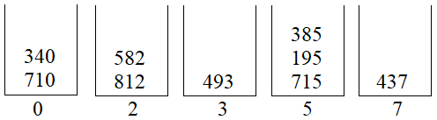
Radix Sort Example
Data: 493, 812, 715, 710, 195, 437, 582, 340, 385
  Start with the least significant digit (the one’s position)
  Gather the same values and put them together in a bucket
    Usually implemented as a list
  “Drain” the buckets in order:
    We end up with: 710, 340, 812, 582, 493, 715, 195, 385, 437
Notes:
Order matters! Don’t do it like a human, do it like a computer!

Slide 34
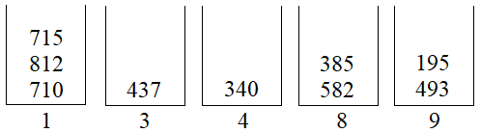
Radix Sort Example
Data: 710, 340, 812, 582, 493, 715, 195, 385, 437
  Now to the next least significant digit (the ten’s position)
  Gather the same values and put them together in a bucket
  “Drain” the buckets in order again:
    We end up with: 710, 812, 715, 437, 340, 582, 385, 493, 195

Slide 35
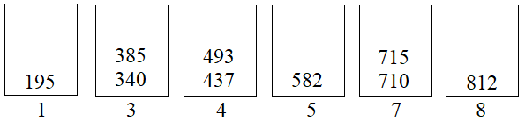
Radix Sort Example
Data: 710, 812, 715, 437, 340, 582, 385, 493, 195
  Now to the last digit (the hundred’s position)
  Gather the same values and put them together in a bucket
  “Drain” the buckets in order again:
    We now have our sorted data:
    195, 340, 385, 437, 493, 582, 710, 715, 812

Slide 36
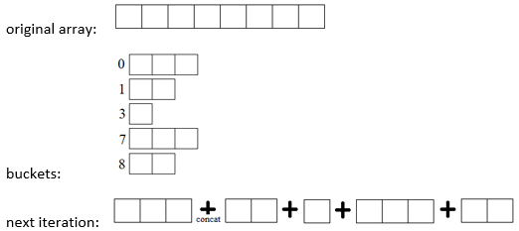
Radix Sort
Time complexity: O(n)
Space complexity: O(n)
  can be optimized depending on data set
Implementation:

